Slide 1

TrafficSense: Urban Traffic Flow Analytics & Congestion Prediction
Big Data Analytics Project | Department of Artificial Intelligence and Data Science Semester 5 | College of Engineering, Cherthala
Abhijeet Rameshkumar Nair (CEC24AD005)
Ananthukrishna CU (CEC24AD014)
Amarnath A
(LCEC24AD061)
Abhinav KP
(LCEC24AD058)

Slide 2

PROBLEM STATEMENT
Problem Statement and Motivation
Root Causes of Urban Congestion
Real-World Impact
Rapid urbanization increasing population density
Steady growth in vehicle ownership
Rising travel demand across metro corridors
Effective traffic analytics can transform urban mobility by enabling:
Analysis of traffic behaviour across time periods
Identification of peak congestion windows
Understanding of congestion trends and patterns
Support for intelligent transportation decisions
Limitations of Existing Systems
Difficulty handling large-scale traffic datasets
Limited analysis of historical traffic patterns
Lack of predictive insights for proactive decisions
Core Need: A scalable Big Data-based traffic analytics system that processes large volumes of historical data and supports congestion prediction.

Slide 3
OBJECTIVES
Project Objectives
Main Objective: Develop a Big Data Analytics framework for analysing urban traffic patterns and supporting congestion prediction using the Metro Interstate Traffic
Volume Dataset.
1
Data Preprocessing
Clean and preprocess raw traffic data; handle duplicates, missing values, and inconsistencies.
2
Feature Engineering
Extract temporal, weather, and holiday-based features from raw data.
3
Pattern Analysis
Analyse traffic volume patterns and identify peak congestion periods.
4
Big Data Processing
Apply Hadoop, Hive, and Apache Spark for scalable distributed processing.
5
ML Prediction Model
Develop a machine learning-based congestion prediction model using MLlib.
6
Visualization Dashboard
Build an interactive Power BI dashboard for traffic insights.

Slide 4
LITERATURE SURVEY
Review of Existing Research
Author & Year | Methodology | Limitation
Zhu et al. (2019) | Survey of Big Data analytics techniques in Intelligent Transportation Systems | No complete practical implementation framework
Nguyen et al. (2022) | Study of Big Data applications in traffic management | Mainly conceptual analysis
Amini et al. (2017) | Distributed Big Data architecture for real-time traffic control | Limited prediction focus
Maarala et al. (2015) | Apache Spark-based traffic stream analytics | Focuses mainly on streaming analytics
Janković et al. (2021) | Machine learning-based traffic flow prediction | Requires historical labelled data
Research Gap: Existing studies focus mainly on individual aspects — prediction, processing, or management. TrafficSense integrates Big Data processing, analytics, prediction, and visualization into a unified framework.

Slide 5
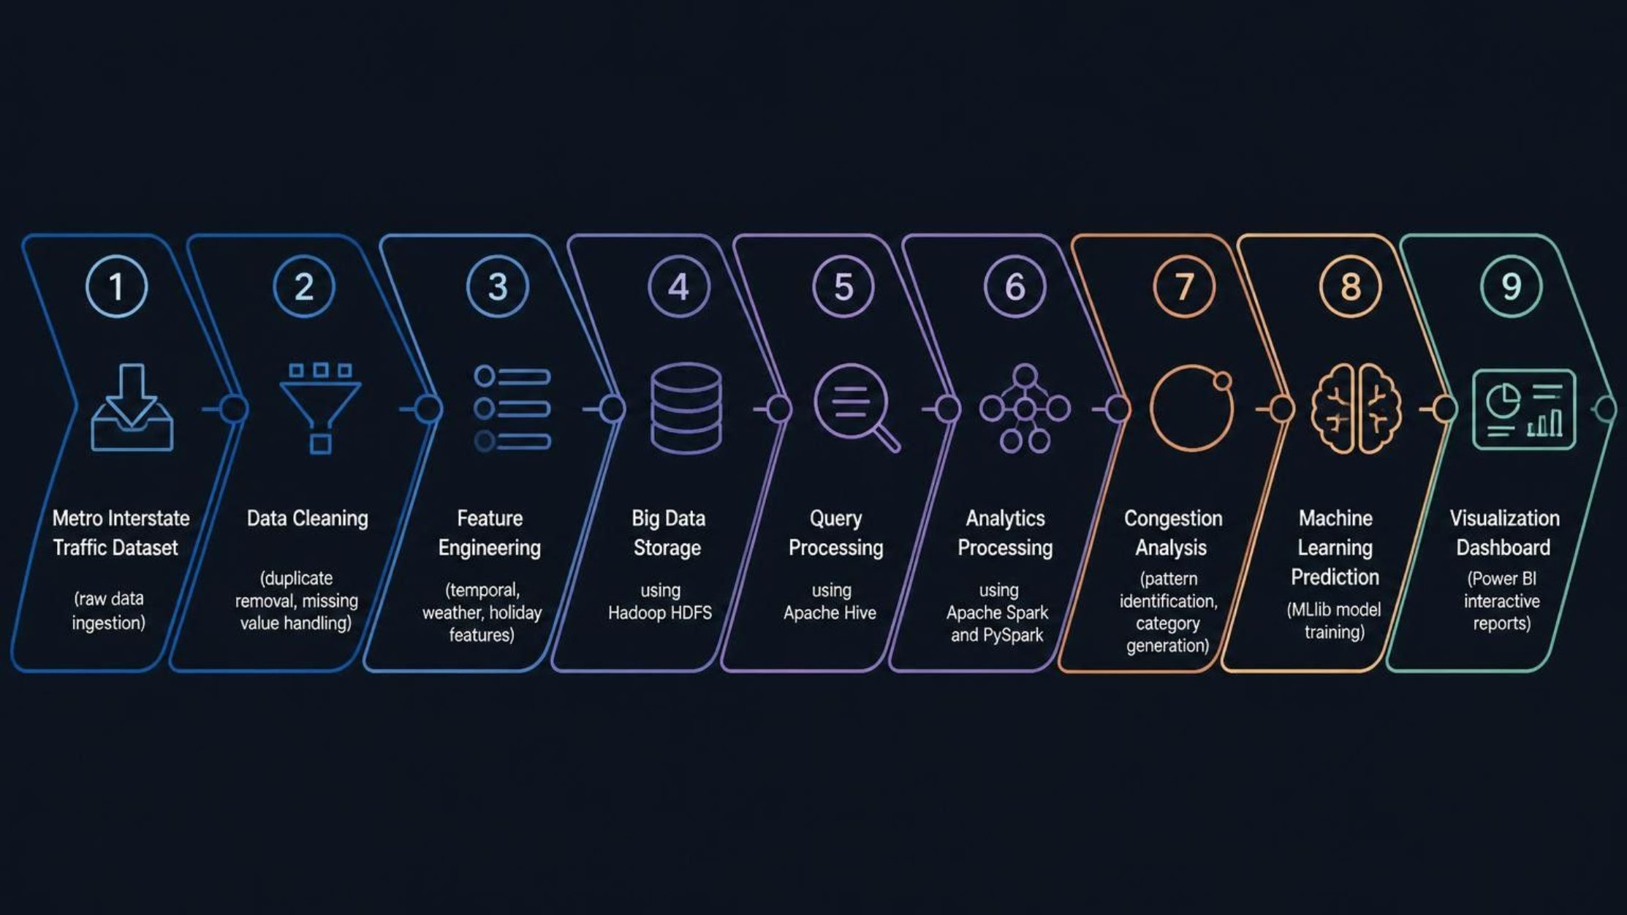
METHODOLOGY
Proposed Methodology
TrafficSense follows a structured multi-stage pipeline, transforming raw traffic data into actionable insights and predictive models.
Data Preparation Phase
Big Data Processing Phase
Analytics & Prediction Phase
Raw data from the Metro Interstate Traffic Dataset is cleaned, deduplicated, and enriched with engineered features including time-of-day, day-of-week, and weather-derived attributes.
Cleaned data is stored in Hadoop HDFS. Apache Hive handles structured queries while Apache Spark and PySpark perform distributed analytics at scale.
Congestion categories are generated from traffic volume thresholds. ML models are trained using Spark MLlib, and results are presented through a Power BI dashboard.

Slide 6
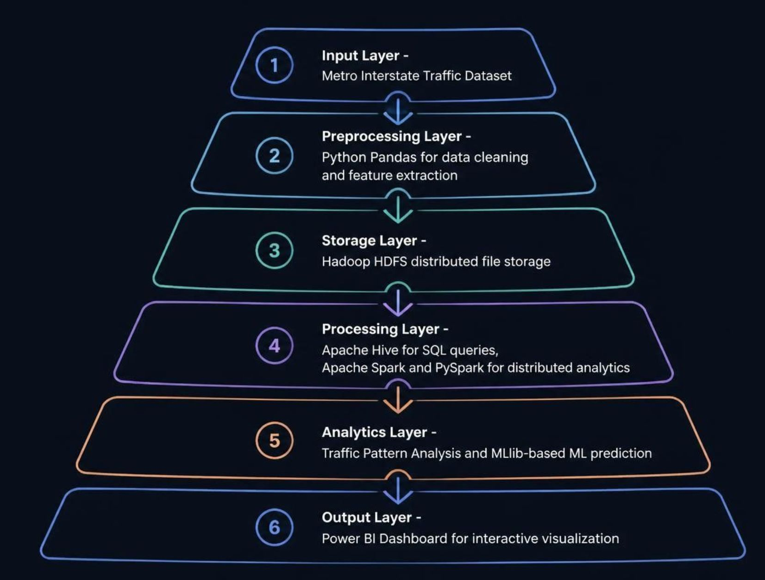
SYSTEM ARCHITECTURE
Big Data System Architecture
TrafficSense is built on a layered Big Data architecture, ensuring scalability, fault tolerance, and efficient distributed processing of large-scale traffic datasets.
Core Big Data Stack
Hadoop HDFS — Distributed, fault-tolerant storage
Apache Hive — SQL-based querying on HDFS
Apache Spark — In-memory distributed processing
PySpark — Python API for Spark analytics
Analytics & Output Stack
Spark MLlib — Scalable machine learning library
Python Pandas — Data manipulation and preprocessing
Power BI — Interactive visualization and reporting

Slide 7
TECHNOLOGY STACK
Tools and Technologies
Programming Languages
Python Libraries
Python — Core data processing and ML
Pandas, NumPy — Data manipulation
Matplotlib — Data visualization
Big Data Technologies
Visualization & Development
Hadoop — Distributed storage (HDFS)
Hive — Data warehouse queries
Spark & PySpark — Distributed analytics
Spark MLlib- Prediction Model
Power BI — Interactive dashboards
Jupyter Notebook — Exploratory analysis
VS Code — Development environment

Slide 8
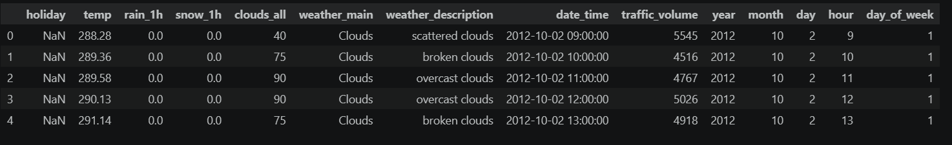
DATASET
Dataset Analysis
Metro Interstate Traffic Volume Dataset
Preprocessing Steps Performed
Duplicate record identification and removal
Date-time feature extraction
Weather-based feature engineering
Congestion category label generation
Source: Kaggle
Original Records: 48,204
Features: 9
Target Variable: Traffic Volume
Sample Data Snapshot
Feature Categories
Date and time stamps
Holiday indicator
Temperature, rainfall, snowfall
Cloud cover, weather type, description

Slide 9
PROJECT PROGRESS
Project Progress
TrafficSense has progressed systematically through the initial phases. Data collection, exploration, and preprocessing are complete. The analytics and ML modules
are currently under active development.
✓ Literature Survey
1
Review of Big Data and ITS research completed.
2
✓ Dataset Collection
Metro Interstate Traffic Volume Dataset sourced from Kaggle.
✓ Data Exploration
3
EDA and statistical profiling completed.
4
✓ Preprocessing
Cleaning, duplicate handling, and feature extraction completed.
✓ Architecture Design
5
Big Data system architecture and pipeline designed.
6
⚙ In Progress
Analytics, ML model, and Power BI dashboard under development.

Slide 10
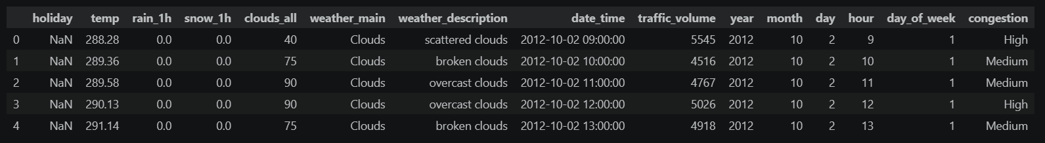
PRELIMINARY RESULTS
Preliminary Results and Data Analysis
Dataset Preprocessing Summary
Original records: 48,204
Processed records: 48,187
Duplicates removed: 17
Cleaning, feature extraction, and congestion category generation: Completed
Dataset after Cleaning:
The cleaned dataset is ready for analytics and machine learning development.

Slide 11
SLIDE 11 OF 15
Individual Contribution
The project workload was distributed across four team members, each contributing to distinct areas of TrafficSense. The table below summarises individual responsibilities across technical implementation, research, visualisation, and documentation.
Team Member | Primary Contributions | Supporting Contributions
Abhijeet Rameshkumar Nair | Primary technical implementation, System architecture design, Project integration | Dataset preprocessing, Feature engineering
Ananthukrishna CU | Literature survey assistance, Dataset selection support | Presentation preparation, Documentation support
Abhinav KP | Visualisation and dashboard development, Analysis support | Testing assistance
Amarnath A | Testing support, Documentation | Project review assistance
All four members collaborated on shared milestones including dataset selection, architecture reviews, and progress presentations to ensure project alignment.

Slide 12
SLIDE 12 OF 15
Challenges Faced and Solutions
Developing TrafficSense involved several technical and analytical challenges. Each was addressed through targeted strategies aligned with Big Data best practices.
🗂️ Handling Large-Scale Traffic Datasets
🧹 Data Cleaning and Preprocessing
📊 Converting Raw Data into Insights
Challenge: Processing large volumes of historical traffic data exceeded single-machine capacity.
Solution: Adopted Hadoop and Spark for distributed, scalable data processing.
Challenge: Raw data contained duplicates, missing values, and inconsistencies.
Solution: Performed duplicate removal, null imputation, and standardisation to produce a clean dataset.
Challenge: Extracting meaningful patterns from raw traffic records required domain-specific transformation.
Solution: Conducted EDA and feature engineering to derive temporal and contextual traffic indicators.
🔗 Integrating Multiple Technologies
📍 Limited Geographical Information
Challenge: Coordinating preprocessing, storage, analytics, and visualisation components was complex.
Solution: Designed a modular pipeline with clearly defined interfaces between each stage.
Challenge: The dataset lacked spatial features such as GPS coordinates or road network data.
Solution: Focused on temporal analysis using time, weather, and traffic volume as primary features.

Slide 13
SLIDE 13 OF 15
Future Work and Enhancements
The next phases of TrafficSense extend the current foundation into a fully functional Big Data analytics and intelligent transportation system. Four key development streams are planned.
1. Machine Learning Model Development
2. Real-Time Traffic Prediction
3. System Enhancement
Train congestion prediction models
Evaluate model performance using standard metrics
Iteratively improve prediction accuracy
Integrate real-time traffic data streams from sensors, GPS, or IoT devices
Implement real-time congestion detection and prediction
Use Apache Kafka/Spark Streaming for continuous data processing
Explore real-time traffic data integration
Improve scalability for larger datasets
Support intelligent transportation applications

Slide 14
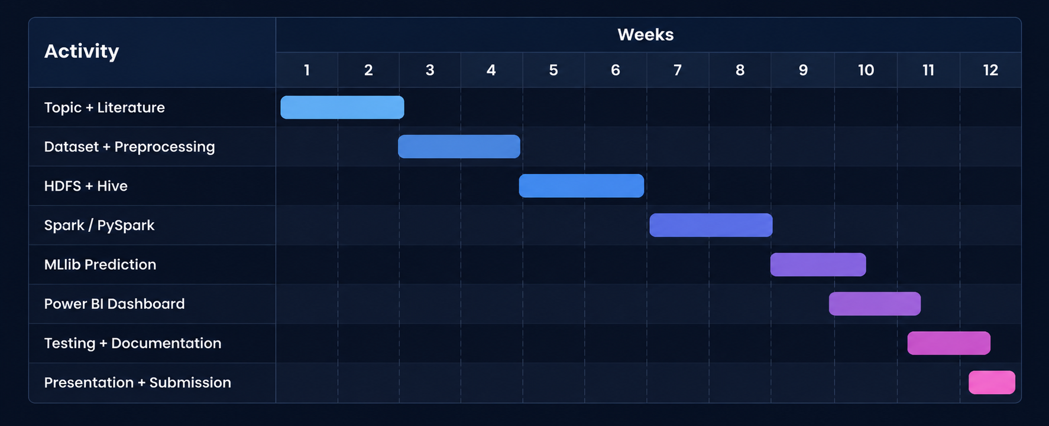

SLIDE 14 OF 15
Project Timeline and Current Status
This project timeline tracks each major activity and its current status across the development lifecycle.
Current Status: The project is in the active development phase. Data preparation and initial analysis are complete. Analytics pipeline, ML model development, and dashboard integration are currently in progress.

Slide 15
SLIDE 15 OF 15
Conclusion
TrafficSense aims to develop a scalable Big Data Analytics framework for urban traffic analysis, congestion pattern extraction, and intelligent transportation support. The project is progressing systematically through defined phases.
Project Focus Areas
Current Achievements
Processing and analysing historical traffic data
Extracting meaningful traffic patterns
Understanding congestion trends
Supporting future congestion prediction
Providing visualisation-based insights
Dataset preparation completed
Data preprocessing completed
System architecture designed
Next Milestone
Complete the analytics pipeline, develop the congestion prediction model, and integrate the interactive dashboard for end-to-end system demonstration.
Thank You
We appreciate the panel's time and feedback. We welcome questions and suggestions for further improvement of TrafficSense.

